Slide 1
Statistical Insight into Diabetes data
Ernesto Rene Monterroso Zamora
Nigar Mutallimova
Orkhan Yagubov

Slide 2
Diabetes
The data set includes variables such as the number of pregnancies the patient has had, her BMI, blood pressure level, insulin level, age, outcome variable which is intended to predict whether the patient has diabetes, and other variables contained in the csv file.
The people surveyed in this particular dataset include women aged 21 and over.

Slide 3
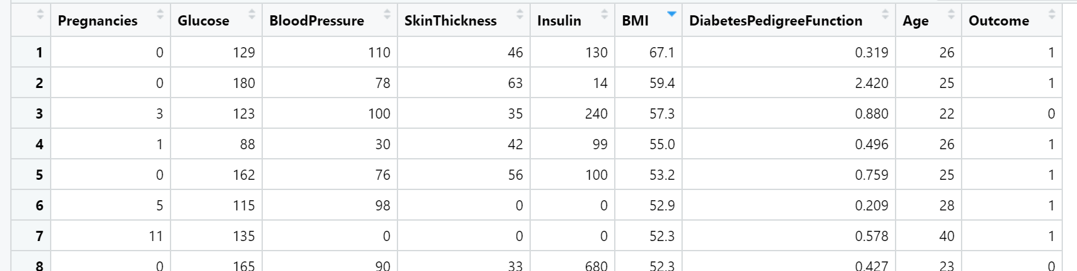
Diabetes data with ‘0’ values

Slide 4
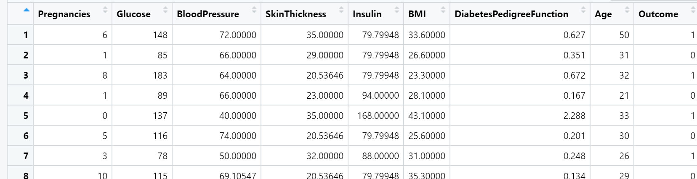
Replacing Missing Values with Mean

Slide 5
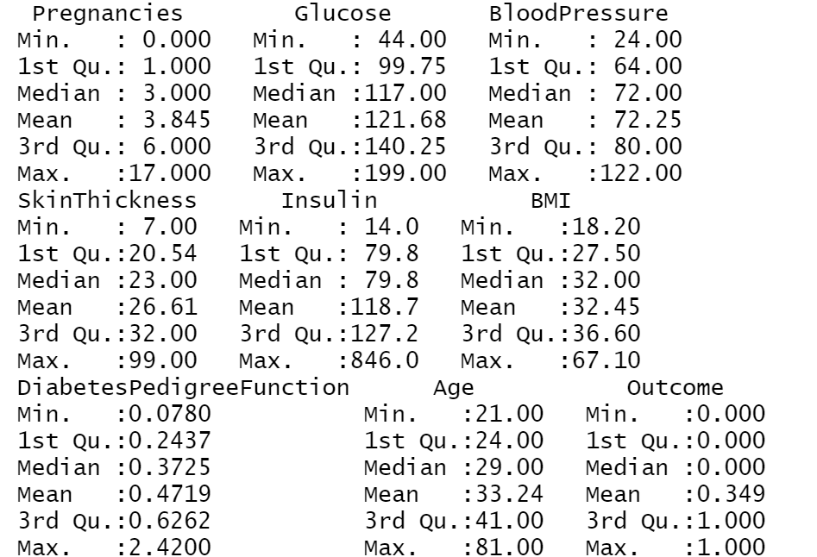
Summary about each column

Slide 6
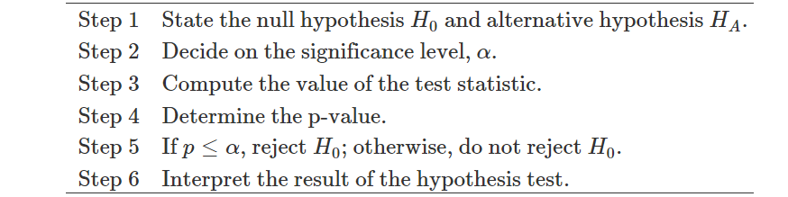
Steps for Hypothesis testing

Slide 7
Is the mean blood pressure of older people and younger ones the same?
D = Avg. blood pressure of older people –Avg. blood pressure of younger people
H0: D = 0
H1: D ≠ 0

Slide 8
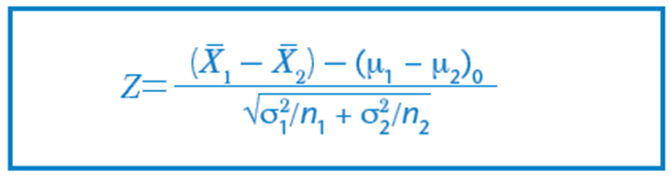
Cases in Which the Test Statistics is Z
The sample size n₁ and n₂ are both at least 30 and the population standard deviations σ₁ and σ₂ are known
Both populations are normally distributed and the population standard deviations σ₁ and σ₂ are known

Slide 9
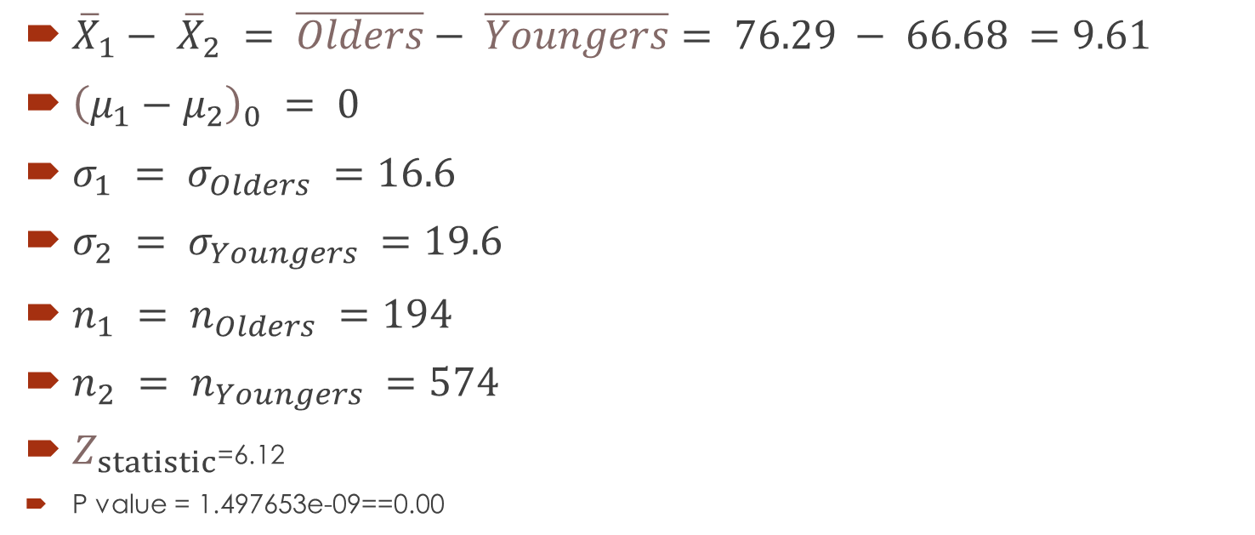
${\overline{X}}_{1}− {\overline{X}}_{2} = \overline{Olders}− \overline{Youngers}= 76.29 − 66.68 =9.61$
${\left(μ_{1}−μ_{2}\right)}_{0} = 0$
$σ_{1} = σ_{Olders} =16.6$
$σ_{2} = σ_{Youngers} =19.6$
$n_{1} = n_{Olders} =194$
$n_{2} = n_{Youngers} =574$
$Z_{statistic}$=6.12
P value = 1.497653e-09==0.00

Slide 10
Logistic Regression Model
Data will can be used to predict if patients could have diabetes.
After a transformation, the model parameters can be interpreted as an odd scale to determine the effect they had on the dependent variable

Slide 11
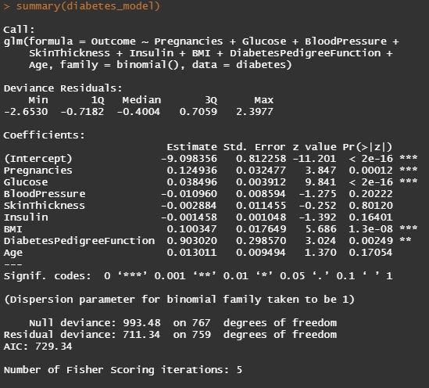
Our model

Slide 12
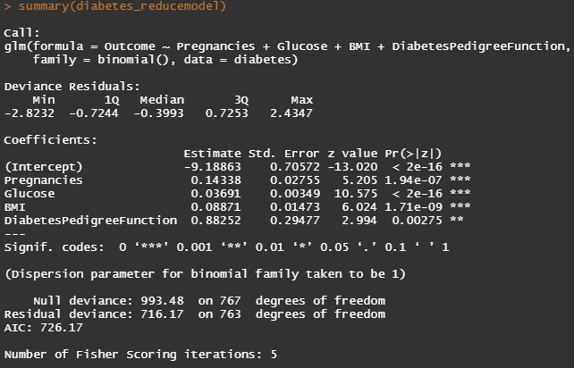
Reduce model

Slide 13
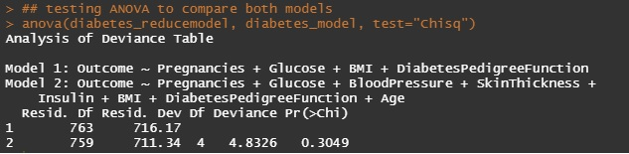
ANOVA test for nested models

Slide 14
Logistic Regression Model assumptions
Appropiate outcome type – binary outcome variable
No strongly influential outliers
No multicollinearity
Indepence of observations
Sufficiently large sample size
Overdispersion (R in Action)
Linearity of independent variables

Slide 15
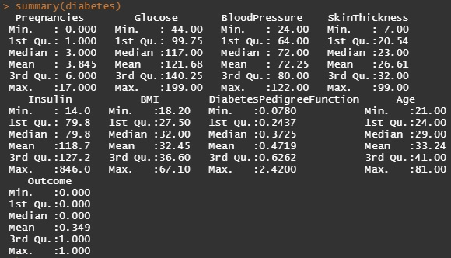
Appropiate outcome type

Slide 16
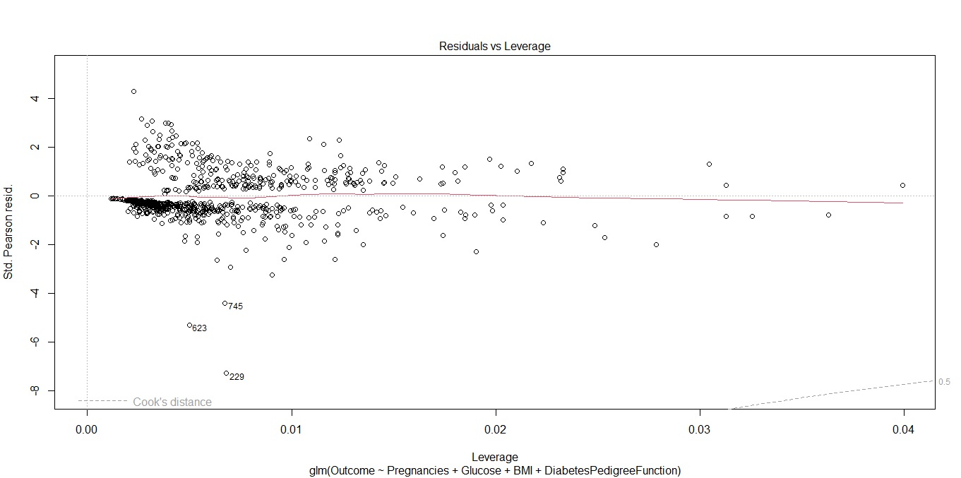
No strongly influential outliers

Slide 17
Independence of observations and Sufficiently large sample size
Our model met this assumption since the data comes from individual patients. If data comes from time series a test should be performed.
Sample size is 768.

Slide 18
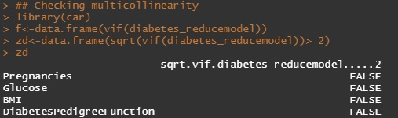
Overdispersion
No Multicollinearity

Slide 19
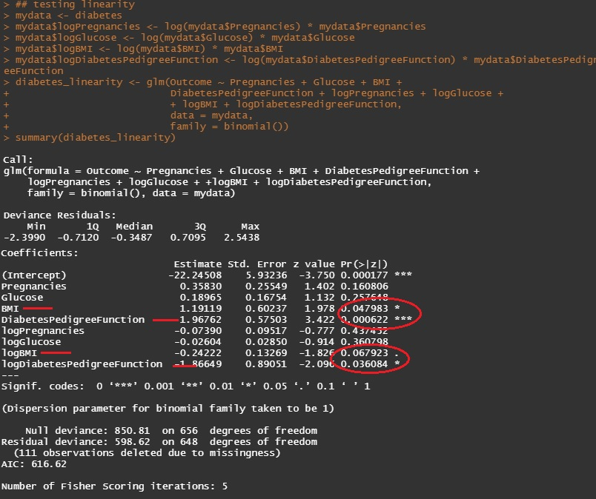
Linearity of Independence variables
Box-Tidwell test
Solutions? Non-linear transformation of independent variables.

Slide 20
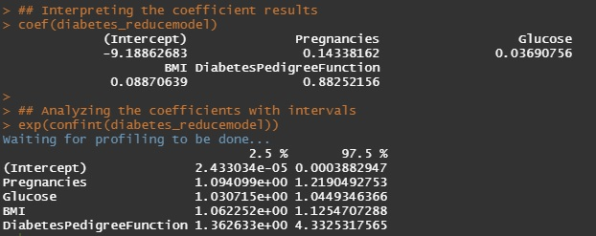
Coefficient interpretation

Slide 21
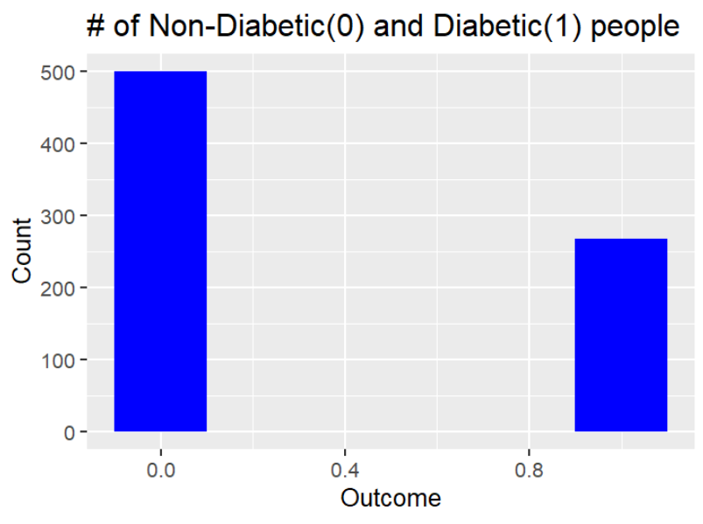
Overall Distribution

Slide 22
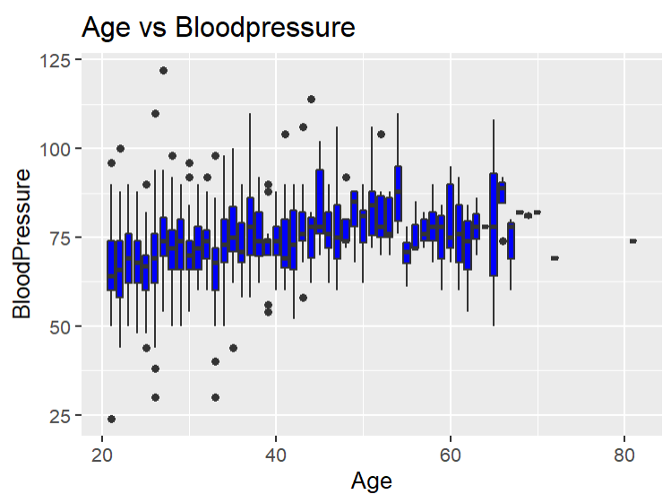
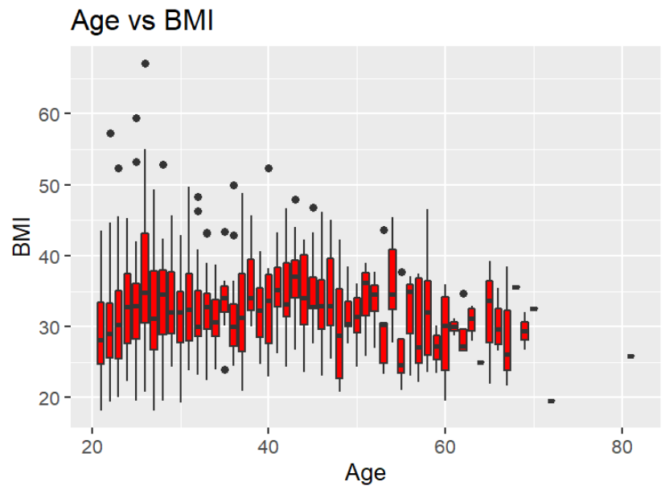
Getting Older

Slide 23
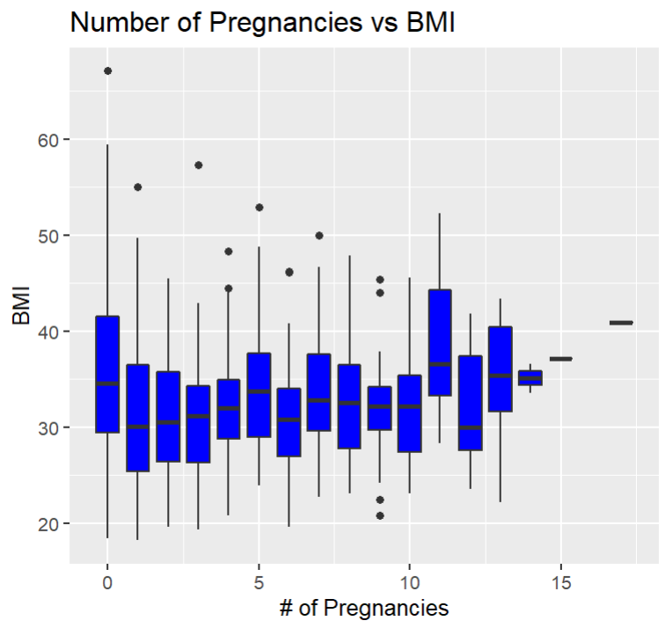
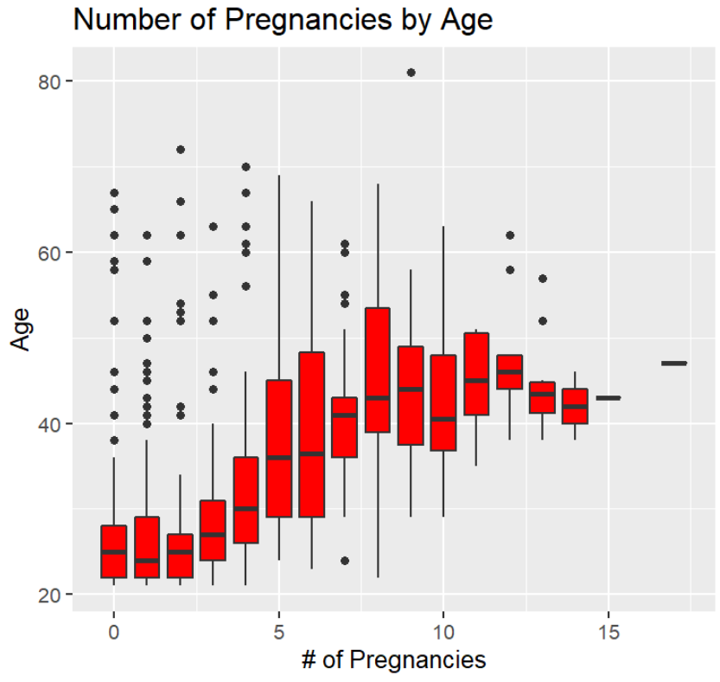
Pregnancy Distribution

Slide 24
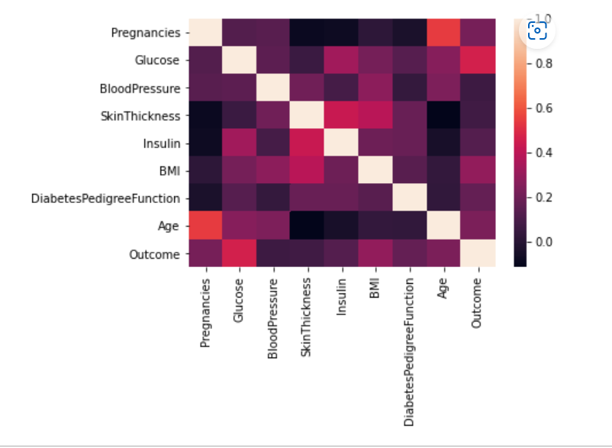
Correlogram

Slide 25
Thank You!

